Slide 1

Web Development Foundations
09
Final Lab Build

Slide 2
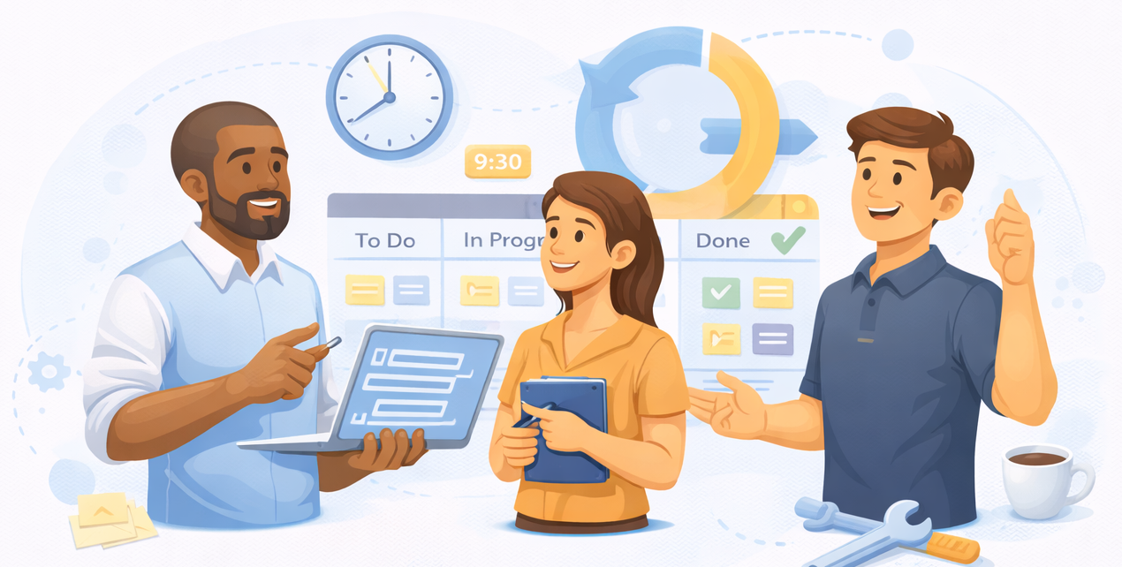
Part 1: The Stand Up Meeting
In a real agile environment, every day starts with a Stand-Up.
Topic: Blockers & Goal Setting
1. What did you finish since the last session?
2. What are you working on today?
3. What is your "Blocker"?

Slide 3

Part 2: Co-Working Sessions (140 m)
Notes:
Topic: 1-on-1 Code Reviews & "Firefighting" This is a deep-work block. The instructor should move around the room (or breakout rooms) to provide:
The "Look-Over-The-Shoulder" Review: Checking if students are using fetch() correctly and handling errors.
The GitHub Audit: Ensuring students are actually closing their Issues via commits.
The Vercel Check: Confirming the live site updates correctly when code is pushed.
Refactoring Advice: Helping students move from "spaghetti code" to clean, reusable functions.

Slide 4
Sprint Planning
Initialize your final Project Repository in github
  Preferably <username>.github.io
Translate the technical brief into 6-8 GitHub Issues
  Examples to be provided
No coding is permitted until the Board is set up
Plan CSS system (colors, spacing) to ensure consistency across all the pages

Slide 5
Part 2: The Shell
Goal: Build the structural foundation and secure the Live URL.
Multi-Page Setup: Creation of index.html and other required files
Shared Components: Building the Responsive Navigation and Footer.
Requirement: The Navigation must be identical and functional on all pages.
Integration: Connecting the GitHub repo to Vercel or setup GitHub pages
Success Metric: Every student ends this hour with a live (though empty) URL.
Atomic Commits: Practice using keywords like Closes #1 in commit messages to automate their GitHub board.

Slide 6
10
Minute Break

Slide 7
Part 3: Checklist
Topic: Preparing for Presentations
Ensure
Mobile Test: Does it work on a real phone?
The README: Is the "Technical Stack" clearly listed?
Presentation Prep: "In Session 10, you will have 5 minutes. You must show: Your Site, Your Code (one specific function), and Your GitHub Issue board."
Notes:
Part 3: The "Pre-Flight" Checklist (20 Minutes)
Topic: Preparing for Presentations (Session 10) Before students leave, they must ensure their project meets the "Launch Standard."

Slide 8
Final Project Evaluation Criteria
Criteria | Exceptional | Developing
Depth of Knowledge | Seamless use of Semantic HTML and complex CSS layouts. | Basic HTML used; layout breaks on some screens.
Methodologies | Site is fully accessible (Aria-labels, Alt-text) and optimized | Some accessibility errors or slow image loading.
Application | JavaScript handles data and events without errors. | JS is present but contains console errors.
Professional Capacity | Live URL works perfectly; GitHub history is professional. | Site is not deployed or lacks a README.

Slide 9
Summary
1. The "Hiring Manager" Test
If I click your Vercel link, does it load in under 2 seconds?
Is your GitHub repo public and professional?
2. The Logic Check
Does the Search/Filter work without crashing?
Did you handle the "Loading..." state while the API fetches data?
3. The Documentation
Does your README explain how to run your project and why you chose your tech stack?
4. The "Show & Tell" Prep
Be ready to explain one specific "win" (the hardest problem you solved) and one "loss" (something you couldn't get working but learned from).

